Slide 1

Smart nudging
26th May 2025
Blitz Brigade
Rupa Iyer, Robert Mati, Janakan Senthilkumar Anthony D'Costa, Jelena Tucci, June Patridge
Notes:
Customers still visit branches for tasks they could easily complete digitally—costing them time, and us, valuable resources. At TD, we reimagine banking with smart nudging—seamlessly guiding users to complete abandoned tasks, repeat actions digitally, and reengage with ease. The future of banking isn’t just open—it’s waiting to welcome you.

Slide 2

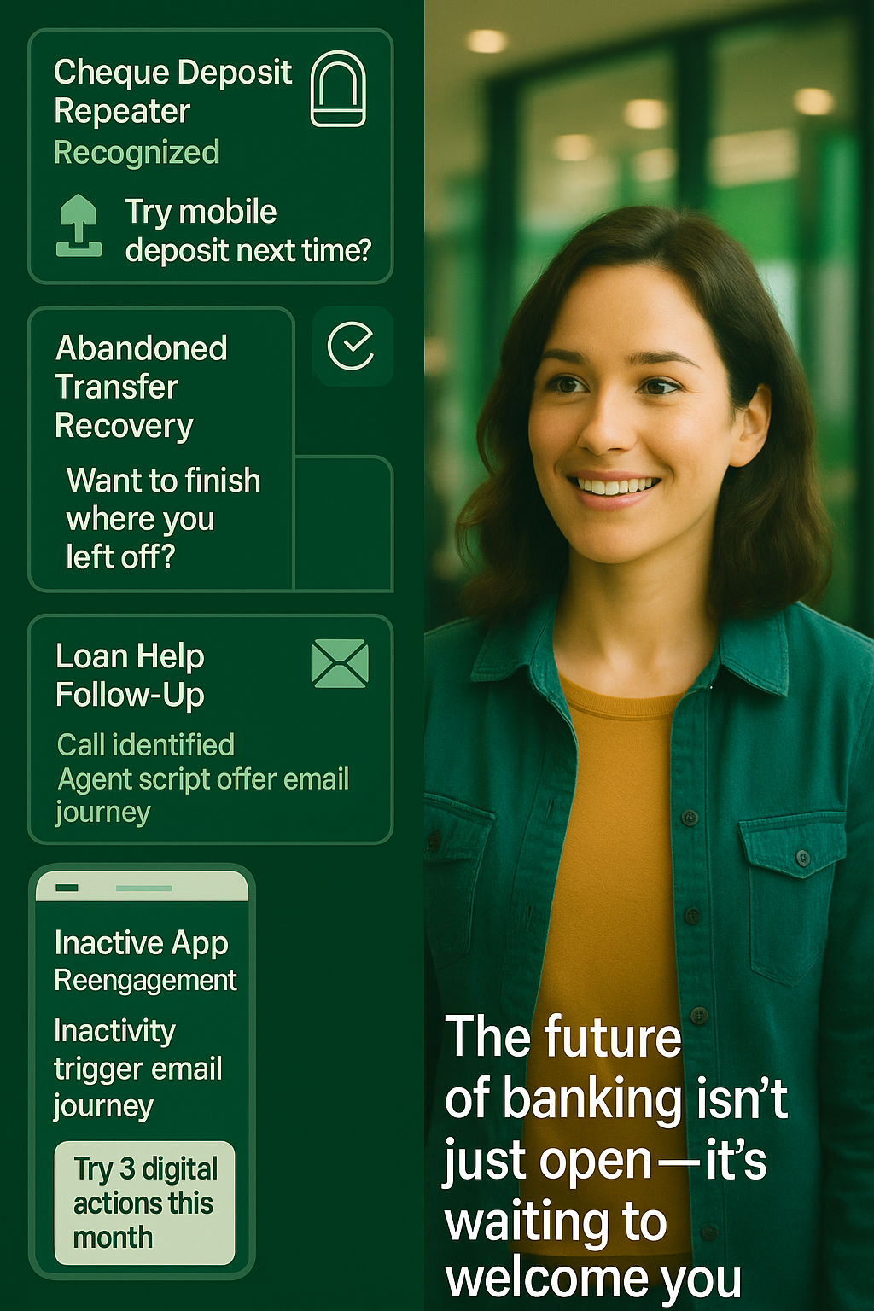
Blitz Brigade Rupa Iyer, Robert Mati, Janakan Senthilkumar Anthony D'Costa, Jelena Tucci, June Patridge
ChimeIn
A smart 'entry chime' that instantly detects, identifies, and greets customers the moment they walk into a branch with a personalized mobile notification.
Smart Nudging Orchestration MCP + AI Rules Engine =
(Real-time behaviour detection )
+
(personalized next best nudges)
📱🧾⬇️
📊❌
Cheque Deposit Repeater
Detects recurring in-branch cheque deposits and nudges customers toward mobile deposit with a personalized in-app message.
Abandoned Transfer Recovery
Identifies incomplete online transfers and re-engages the customer via SMS to resume and complete the action.
📞📄💲
Loan Help Follow up
Recognizes support calls for loans and equips agents with contextual scripts to guide customers toward digital completion.
📱💤
Dormant digital users
Flags dormant users and triggers a gamified email campaign encouraging reactivation through simple digital tasks.
Impact & Benefits
These smart context-aware journeys strengthen our branch and digital experience by offering proactive personalized service that exceeds expectations at key touchpoints – supporting LEI uplift across Branch Service Excellence, Customer Service Excellence and Mobile Banking Excellence. 🌟frictionless 🌟attentive 🌟 omnichannel 🌟inclusion
Video Pitch Link
Know when they arrive. Engage instantly
Notes:
Know when they arrive. Engage instantly
Meet Chimeln — the intelligent entry chime designed to recognize customer presence the moment they walk in and activate personalized nudges powered by AI. Think of it as a smart “chime" that blends presence detection with real-time behavioral insights to deliver the next best digital action — instantly. Whether it's nudging repeat cheque depositors to go mobile, recovering abandoned transfers with a contextual SMS, offering loan assistance through tailored agent scripts, or re-engaging dormant app users through gamified email prompts, Chimeln is frictionless, attentive, omnichannel, and inclusive by design. Clean and developer-friendly, it's built for seamless integration across APIs, enhancing every branch interaction with digital precision.

Slide 3
ChimeIn | Estimated Annual Savings from Digital Shift via Nudging.
Total Potential Annual Benefit ~ $4 – 5 million
Potential Annual Benefit
Smart Nudge Impact
Branch Activity | Use Cases | Est. Annual Savings
Cheque Deposit Repeater | - Customers who have used some digital features and are ready to be nudged further - Habitually prefer in-person service; may be unaware of mobile deposit. | ~$2.9M
Loan Help Follow-Up | - Chequing Account Sales (Existing + New) - Savings Account Sales - Credit Card Sales | ~$2.8M
Abandoned Transfer Recovery | -Recover 5% of failed digital transfers through smart nudging -Outgoing Wire Payments (Personal) | ~$0.5M - $1M
Dormant Digital users | -Customer has not used app in 60+ days | ~unlocked value
Shifting just 10% of cheque deposits to mobile deposit could save ~$2.9M/year
Faster handoff and digital co-completion could reduce handle time from ~6–16 minutes to ~3–5 minutes, ~50% time savings per interaction
Recovering just 20% through in-branch or digital prompt, ~$1.07M/year saved in rework and duplication.
Recovery of just 5% of incomplete digital transfers using prompts , $0.5M - $1M/year saved in rework.
Reduces future service costs and unlocks millions.
Notes:
This slide from ChimeIn shows how using MCP and AI-driven nudging can shift routine branch activities like cheque deposits, loan help, and abandoned transfers to digital channels. By identifying the right moment to prompt customers—whether through mobile, email, or staff—TD can save an estimated $4–5 million annually, improve customer experience, reduce wait times, and boost digital adoption with data-driven personalization.

Slide 4

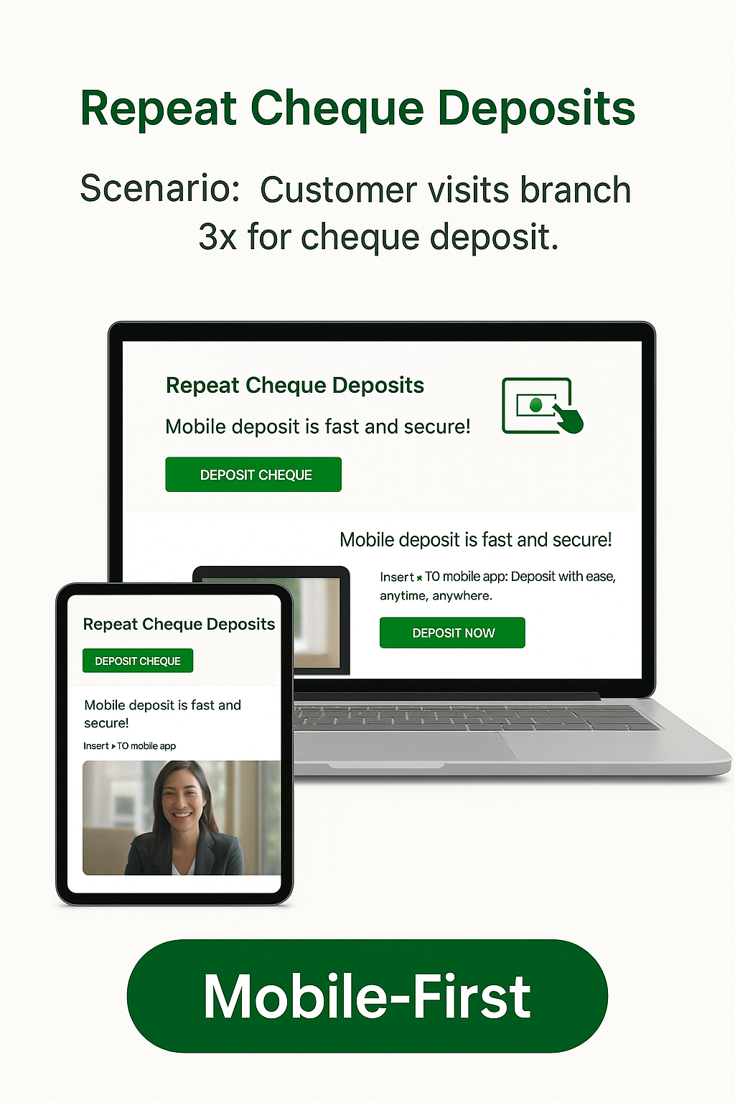



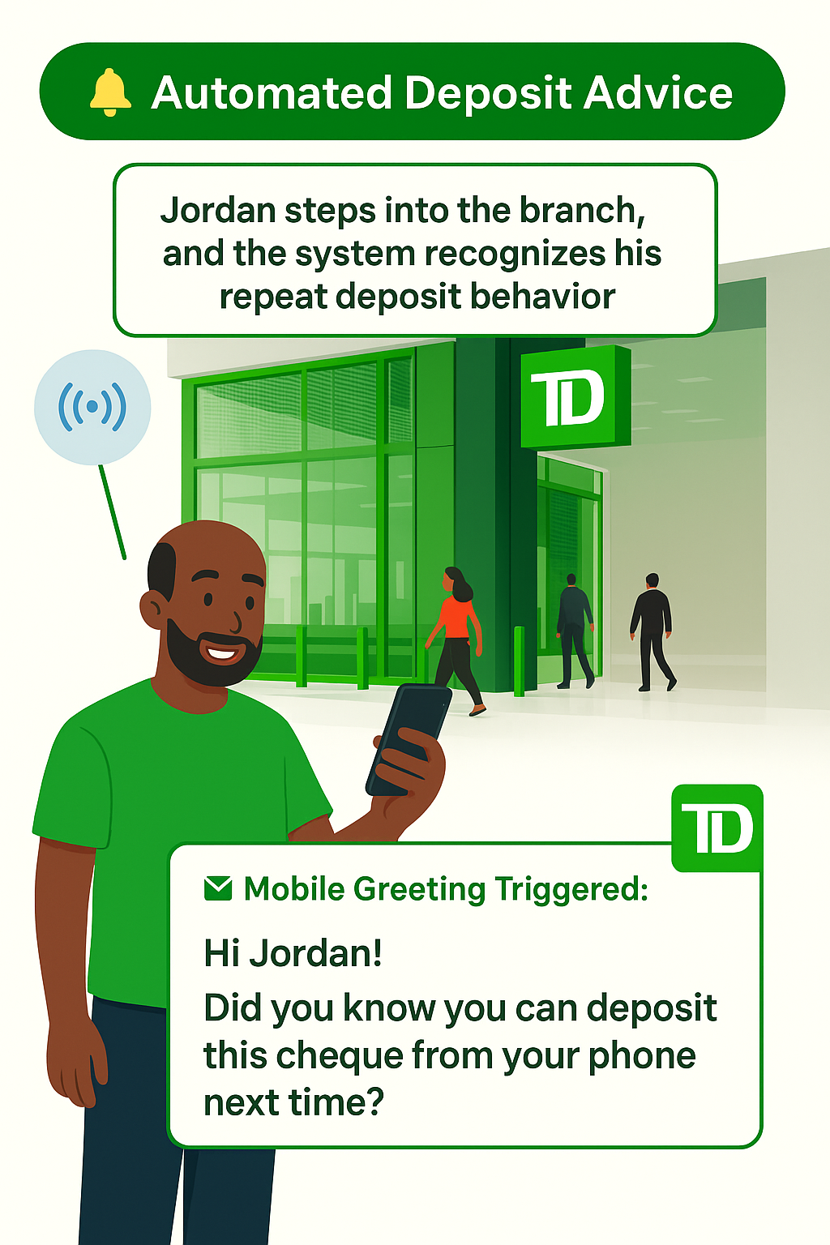

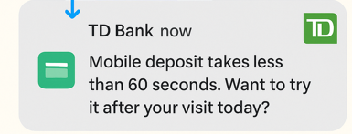
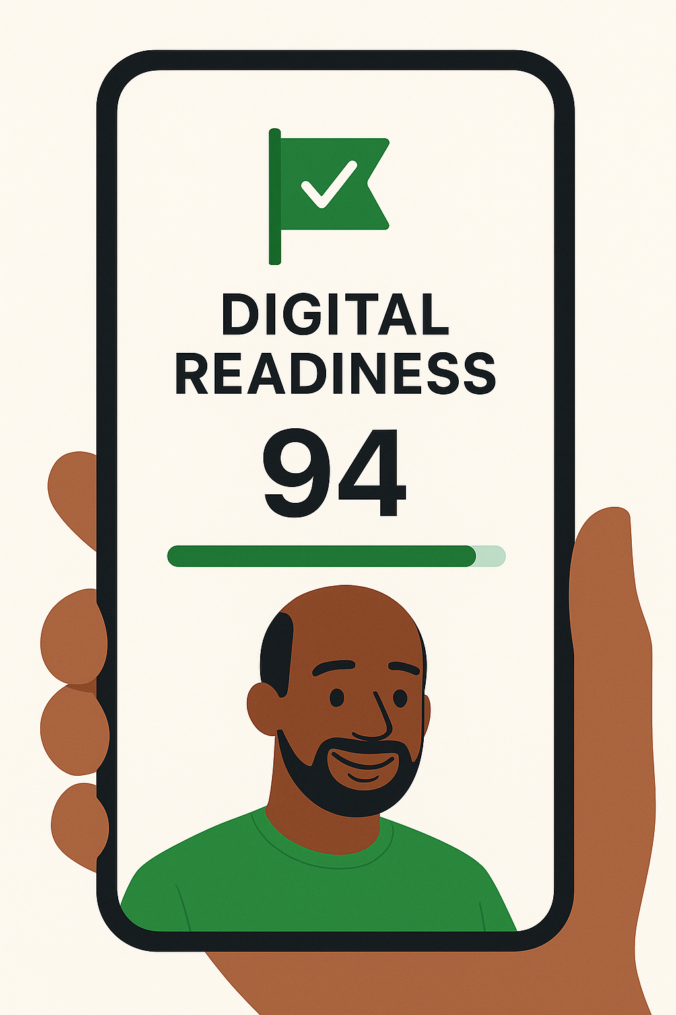
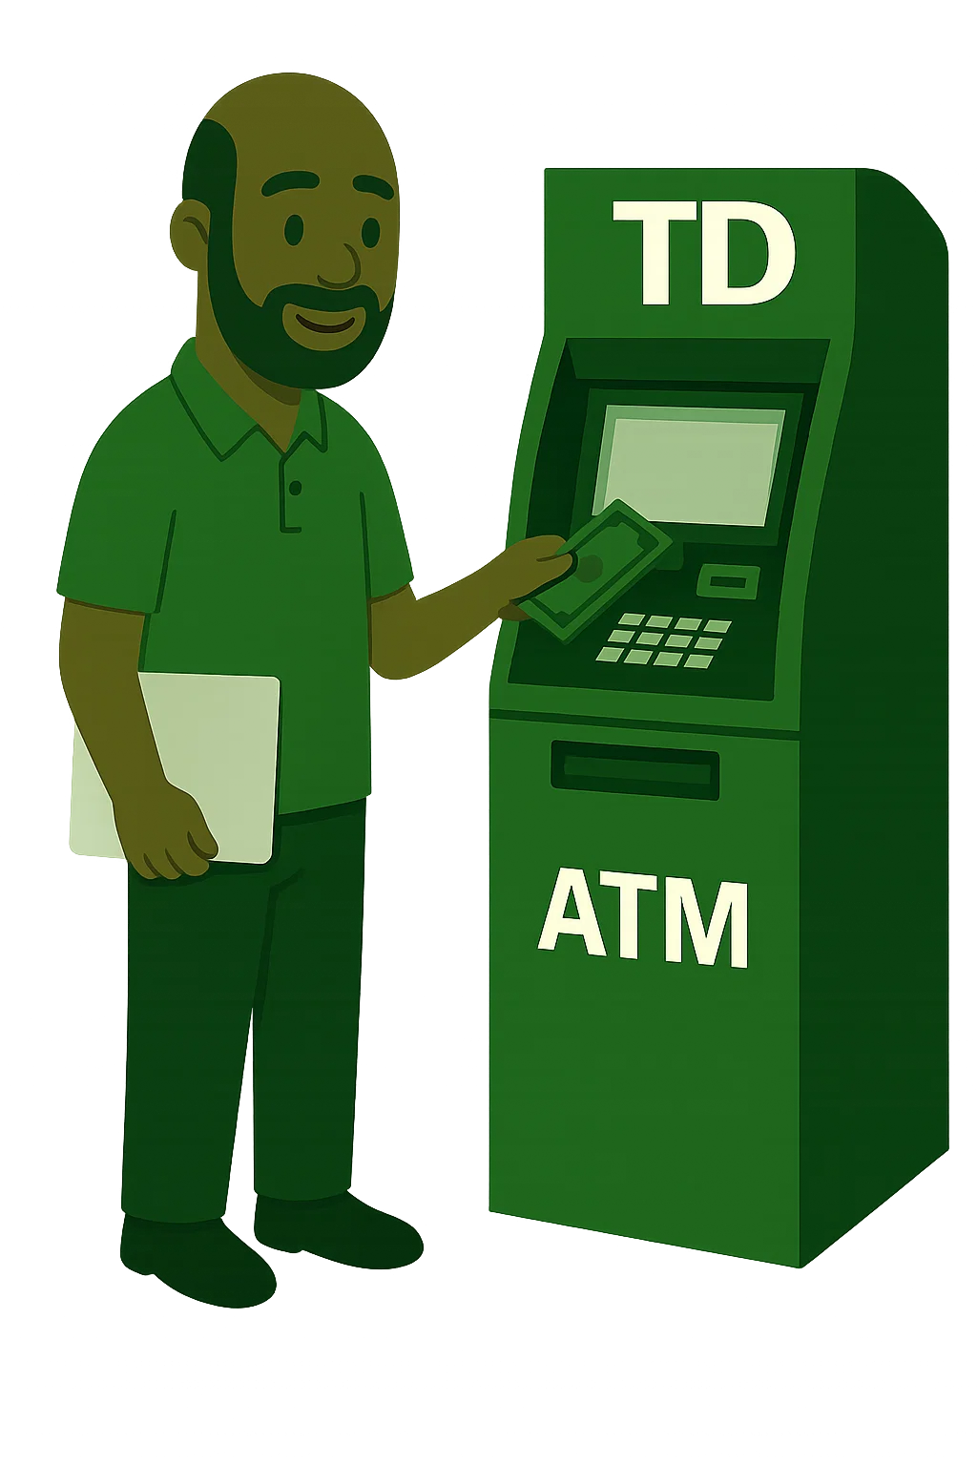

ChimeIn | Cheque deposit repeater
Meet Jordan - He’s a small business owner who runs a local landscaping company and deposits cheques from clients every week. Jordan prefers the branch, but values speed and flexibility. After his third visit this month, the system recognizes a pattern…
4
 | https://sora.chatgpt.com/g/gen_01 jvwrf811f4btq74ds0rnqmt0 |  | Jordan tries mobile cheque deposit for the first time. His DRS increases. Branch load decreases. Jordan’s satisfaction goes up. + Data & Analytics
2
5
The concierge sees Jordan’s digital readiness score (DRS )and nudging flag
1
6
Jordan is thinking of
dropping a cheque at the branch.
3
I can show you how to use the app, so you don’t have to wait in line.
Notes:
Jordan visits the branch multiple times a month to deposit cheques. Using the Model Context Protocol (MCP), the system recognizes his pattern and triggers a personalized mobile message the moment he walks in.
The AI rules engine determines that this is a simple task he could do digitally. It sends Jordan a friendly nudge:
“Hi Jordan! You can deposit cheques from your phone next time.”
At the same time, staff see his Digital Readiness Score (DRS) and are prompted to offer assistance.
“I can show you how to use the app, so you don’t have to wait in line.”
As a result:
Jordan tries mobile deposit for the first time
His DRS increases
The branch is less congested
And Jordan walks away more satisfied
Data and analytics capture the whole journey, helping us improve future nudges.

